Slide 1



Neural Networks Project
Presented to:
Dr. Mona Farouk
Presented by:
Yousef Hazem Hanafi
Shehabeldeen Yousef
235359
235725

Slide 2


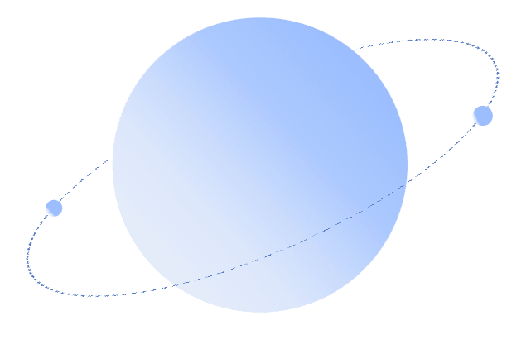

01
Project Overview
04
Model Architecture
2
2
02
Dataset Description
05
Results & Evaluation
2
2
03
Data Preprocessing
06
Conclusion & Insights

Slide 3



01
Project Overview

Slide 4

Project Overview
Repeat Purchase Prediction with MLP
This project utilizes a Multi-Layer Perceptron (MLP) to predict repeat buyers from transactional data. The goal is to identify customers likely to make repeat purchases, aiding targeted marketing and maximizing Customer Lifetime Value (CLV).
MLP Neural Network
A fundamental deep learning architecture for classification.
Business Value
Enhance marketing strategies and resource allocation.

Slide 5

Why Predict Repeat Purchases?
Targeted Marketing
Resource Allocation
Maximize CLV
Identify and focus on high-value customers to increase campaign effectiveness.
Optimize marketing spend by efficiently allocating resources to the right customer segments.
Enhance Customer Lifetime Value through personalized engagement and retention strategies.
This project applies deep-learning fundamentals to a complex, real-world retail dataset.

Slide 6
Problem Statement
The Challenge of Predicting Customer Behavior
E-commerce Challenge
Neural Network Application
Accurately predicting repeat purchase behavior is essential for modern e-commerce success.
This project applies neural networks to real-world data, transforming transaction records into customer-level predictions.

Slide 7
02
Dataset Description

Slide 8
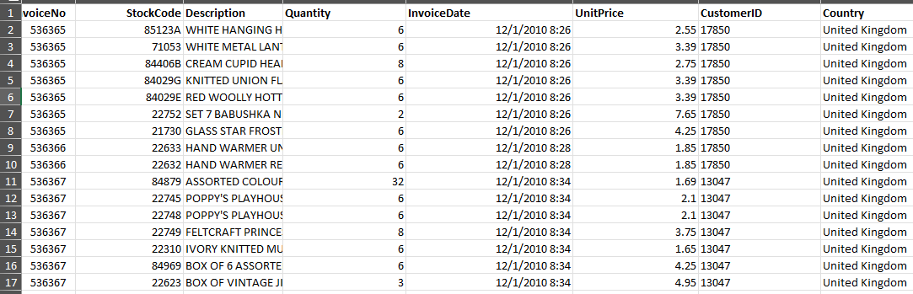
Dataset Overview
Online Retail Data
The project utilizes the Online Retail dataset, chosen for its complexity and real-world applicability. It contains all transactions for a UK-based online retail store over a one-year period.
541,909
01/12/2010
Transactions
to 09/12/2011

Slide 9
Key Data Features
Raw Transaction Details
InvoiceNo & StockCode
Unique identifiers for each transaction and product.
InvoiceDate
Quantity
UnitPrice
Date and time of the transaction.
Amount of product purchased.
Price per unit of product.

Slide 10
03
Data Preprocessing

Slide 11
Data Cleaning & Filtering
Remove Invalid
Raw Data
Create Feature
Missing CustomerID
Non-positive Quantity/Price
541,909 Transactions
TotalPrice = Quantity * UnitPrice

Slide 12
RFM Feature Engineering
Transforming Transactions into Customer Insights
Recency
Frequency
Monetary
Days since last purchase
Number of unique invoices
Total money spent
AvgQuantity
Country
Average items per transaction line.
Customer's primary country.

Slide 13
Repeat_Buyer: A Binary Classification
The target is derived directly from the Frequency feature, creating a clear classification task.
1
IF Frequency > 1 (More than one unique invoice)
Target Definition
0
ELSE
(Only one purchase)

Slide 14
04
Model Architecture

Slide 15
Multi-Layer Perceptron Architecture
Input Layer (RFM Features)
↓
Dense (64 units, ReLU)
↓
Dropout (0.3)
↓
Dense (32 units, ReLU)
↓
Dropout (0.3)
↓
Output (1 unit, Sigmoid)

Slide 16
Training Configuration
Loss Function: Binary Cross-Entropy
Optimizer: Adam
Metrics: Accuracy
Regularization: Dropout (0.3) & Early Stopping
Data Split: Stratified 80-20 Train-Test
Preprocessing: StandardScaler, SMOTE, Feature Engineering

Slide 17
05
Results & Evaluation

Slide 18
MLP Model Performance
Exceptional Results on Test Set
82.5%
Classification Report
Class | Precision | Recall | F1-Score
Non-Repeat (0) | 0.67 | 0.76 | 0.71
Repeat (1) | 0.90 | 0.85 | 0.87
Accuracy | 0.825
Test Accuracy
0.87
F1-Score (Repeat Buyers)

Slide 19
Comparison with Random Forest
Validating Results with an Ensemble Method
MLP (This Project)
Random Forest Classifier
82.5%
82.9%
Accuracy
Accuracy
F1-Score: 0.71 - 0.87
F1-Score: 0.71 - 0.88
Both models performed exceptionally well, confirming the high quality and predictive power of the engineered RFM features.

Slide 20

Surpassing Literature Benchmarks
Our models significantly outperform prior results on the same dataset, validating our feature engineering and preprocessing approach.
Second Best (XGBoost) - 73.9%
Prior Best (Decision Tree) - 74.2%
Our MLP - 82.5%
Our Random Forest - 82.8%

Slide 21
06
Conclusion & Insights

Slide 22
Key Takeaways
The project successfully demonstrated the application of an MLP for customer behavior prediction. The high performance validates the entire data science pipeline, from engineering to modeling.
MLP Success
The MLP effectively learned to distinguish repeat buyers with high accuracy (82.5%).
RFM Power
The RFM features were highly predictive, forming a strong foundation for the model.

Slide 23
Future Directions
From Classification to Time-Series Prediction
Current Model
Future Work
Predicts if a customer is a repeat buyer based on historical data.
Predict when a customer will make their next purchase.
This would introduce a time-series element, creating a more challenging and dynamic prediction task.

Slide 24



ＴＨＡＮＫＳ

